Slide 1

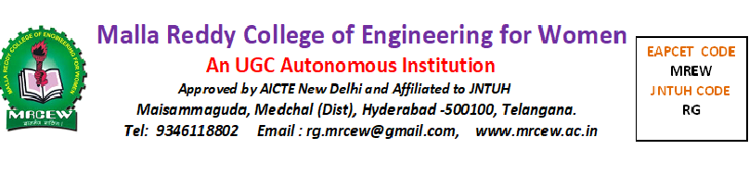
“SeSPHR A Methodology for Secure Sharing of Personal Health Records in the Cloud”
Submitted by
P.POOJA 21RG1A0540
S.ARCHANA 21RG1A0550
S.KAVYACHANDRIKA 21RG1A0552
T.AKHILA 22RG5A0506
Under the Guidance of
AVYAKTHA.E
M.TECH
ASSISTANT PROFESSOR

Slide 2
CONTENT
Abstract
Introduction
Existing System
Literature Survey
Proposed Method
Hardware & Software Requirements
Advantages
Result Analysis
Future Scope
Conclusion
References

Slide 3
ABSTRACT
With the popularity of wearable devices, along with the development of clouds and cloud let technology, there has been increasing need to provide better medical care. The processing chain of medical data mainly includes data collection, data storage and data sharing, etc.
Traditional healthcare system often requires the delivery of medical data to the cloud, which involves users’ sensitive information and causes communication energy consumption.
Practically, medical data sharing is a critical and challenging issue. Thus in this paper, we build up a novel healthcare system by utilizing the flexibility of cloudlet. The functions of cloudlet include privacy protection, data sharing and intrusion detection.

Slide 4
INTRODUCTION
In the stage of data collection, we first utilize Number Theory Research Unit (NTRU)method to encrypt user’s body data collected by wearable devices. Those data will be transmitted to nearby cloudlet in an energy efficient fashion. Secondly, we present a new trust model to help users to select trustable partners who want to share stored data in the cloudlet.
The trust model also helps similar patients to communicate with each other about their diseases. Thirdly, we divide users’ medical data stored in remote cloud of hospital into three parts, and give them proper protection.
Finally, in order to protect the healthcare system from malicious attacks, we develop a novel collaborative intrusion detection system (IDS) method based on cloudlet mesh, which can effectively prevent the remote healthcare big data cloud from attacks. Our experiments demonstrate the effectiveness of the proposed scheme.

Slide 5
SYSTEM ANALYSIS
EXISTING SYSTEM
Lu etal. proposed a system called SPOC, which stands for the secure and privacy-preserving opportunistic computing framework, was proposed to treat the storage problem of healthcare data in a cloud environment and addressed the problem of security and privacy protection under such an environment.
Cao et al., an MRSE (multi keyword ranked search over encrypted data in cloud computing) privacy protection system was presented, which aims to provide users with a multi-keyword method for the cloud’s encrypted data. Although this method can provide result ranking, in which people are interested, the amount of calculation could be cumbersome.
In Zhang et al., a priority based health data aggregation (PHDA) scheme was presented to protect and aggregate different types of healthcare date in cloud assisted wireless boby area network (WBANs).

Slide 6
LITERATURE SURVEY
.
A. N. Khan, ML M. Kiah, S. A. Madani, M. Ali, and S. Shamshirband, “Incremental proxy re- encryption scheme for mobile cloud computing environment,” The Journal of Supercomputing, Vol. 68, No. 2, 2014, pp. 624-
651.
R. Wu, G.-J. Ahn, and H. Hu, “Secure sharing of electronic health records in clouds,” In 8th IEEE International Conference on Collaborative Computing:
Networking, Applications and Work
Abbas and S. U. Khan, “A Review on the State-of-the-Art Privacy Preserving Approaches in E- Health Clouds,” IEEE Journal of Biomedical and Health Informatics, vol. 18, no. 4, pp. 1431-1441, 2014.
M. H. Au, T. H. Yuen, J. K. Liu, W. Susilo, X. Huang, Y. Xiang, and Z. L. Jiang, “A general framework for secure sharing of personal health records in cloud system,” Journal of Computer and System Sciences, vol. 90, pp, 4

Slide 7
PROPOSED METHOD
This paper proposes a cloud let based healthcare system. The body data collected by wearable devices are transmitted to the nearby cloudlet. Those data are further delivered to the remote cloud where doctors can access for disease diagnosis.
According to data delivery chain, we separate the privacy protection into three stages. In the first stage, user’s vital signs collected by wearable devices are delivered to a closet gateway of cloudlet. During this stage, data privacy is the main concern. In the second stage, user’s data will be further delivered toward remote cloud through cloudlets.

Slide 8
HARDWARE&SOFTWARE REGUIREMENTS
HARDWARE REQUIREMENTS:
System : Pentium Dual Core.
Hard Disk : 120 GB.
Monitor : 15’’ LED
Input Devices : Keyboard, Mouse
Ram : 1 GB
SOFTWARE REQUIREMENTS:
Operating system : Windows 7.
Coding Language : JAVA/J2EE
Tool : Net beans 7.2.1
Database : MYSQL

Slide 9
ADVANTAGES
A cloudlet based healthcare system is presented, where the privacy of users’ physiological data and the efficiency of data transmissions are our main concern. We use NTRU for data protection during data transmissions to the cloudlet.
In order to share data in the cloudlet, we use users’ similarity and reputation to build up trust model. Based on the measured users’ trust level, the system determines whether data sharing is performed.
We divide data in remote cloud into different kinds and utilize encryption mechanism to protect them respectively.
We propose collaborative IDS based on cloudlet mesh to protect the whole healthcare system against malicious attacks.

Slide 10
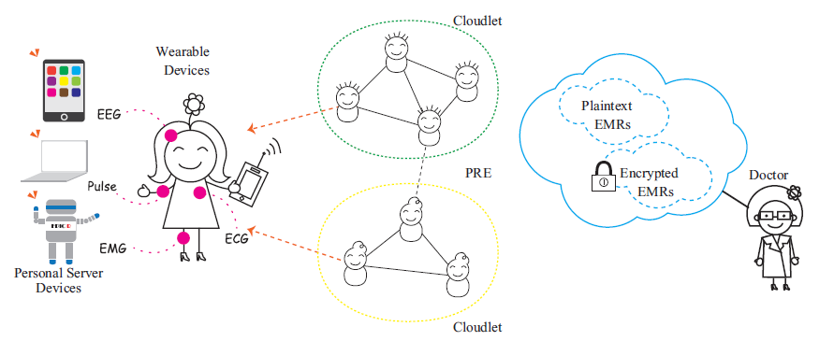
SYSTEM ARCHITECTURE

Slide 11

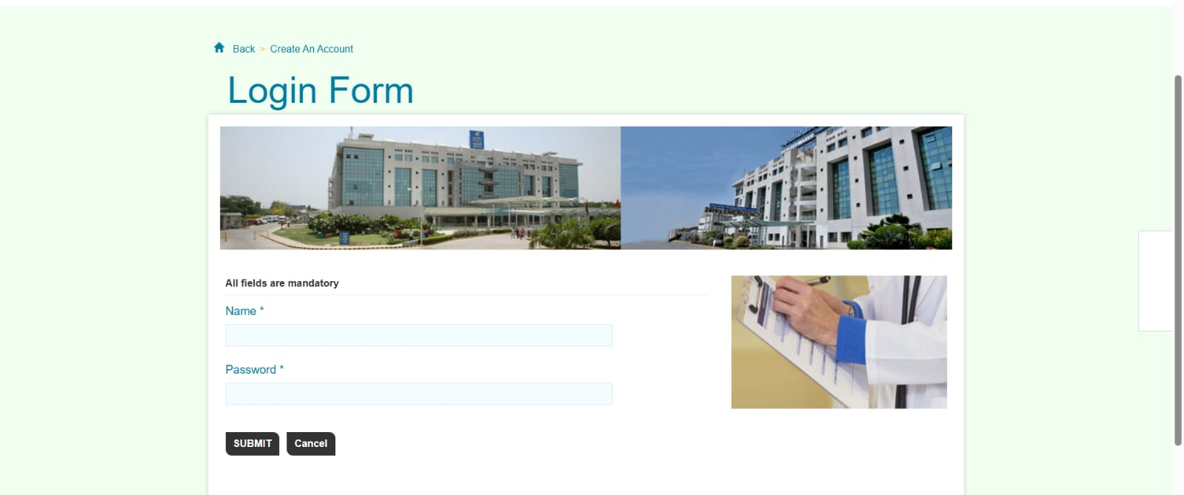
RESULT

Slide 12
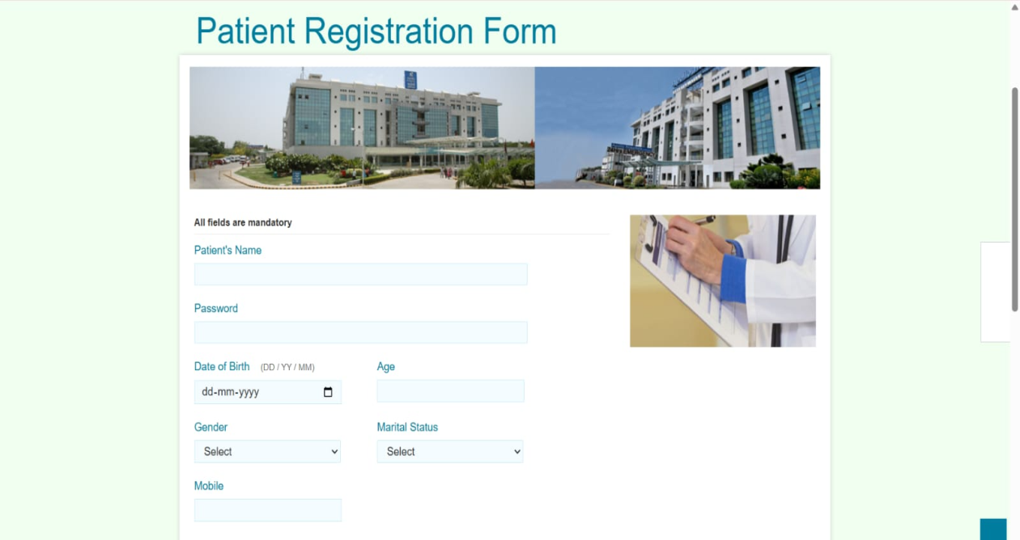


Slide 13
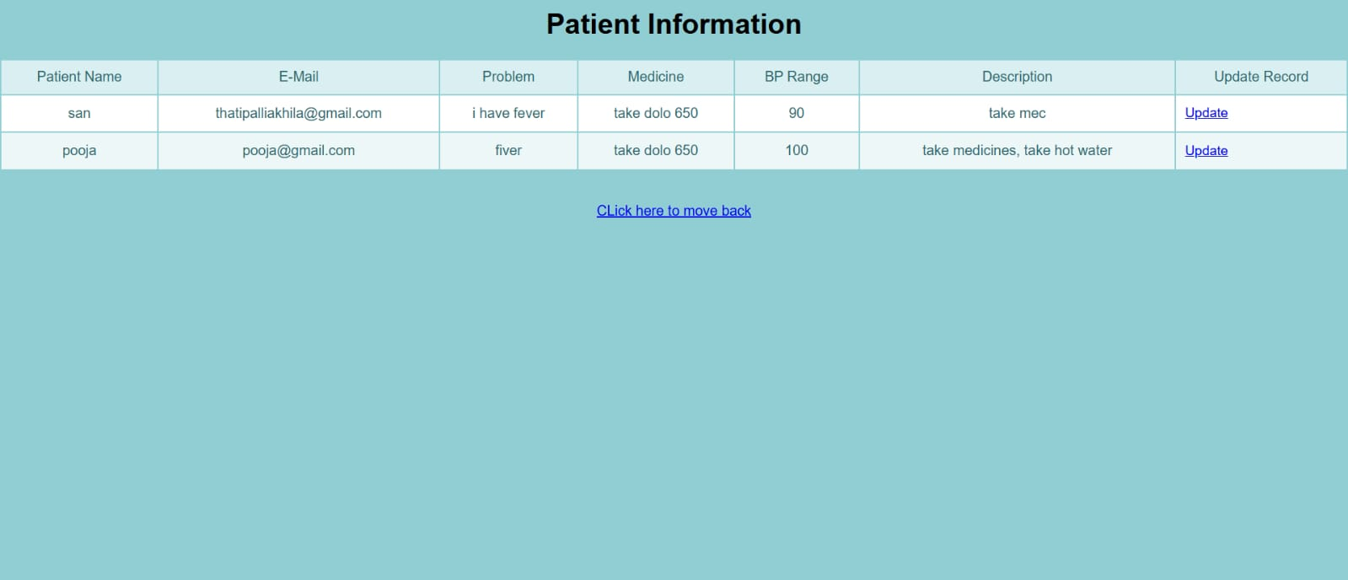
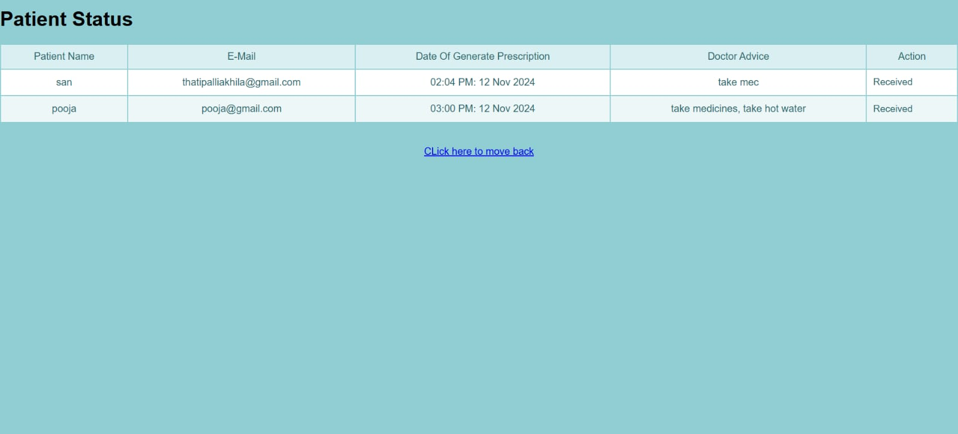

Slide 14
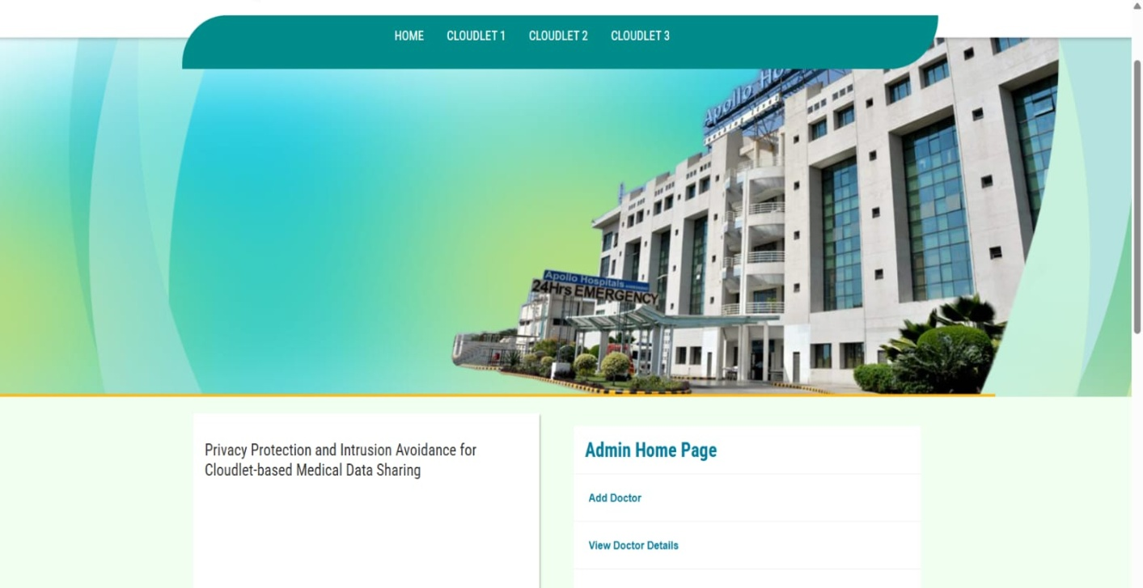

Slide 15
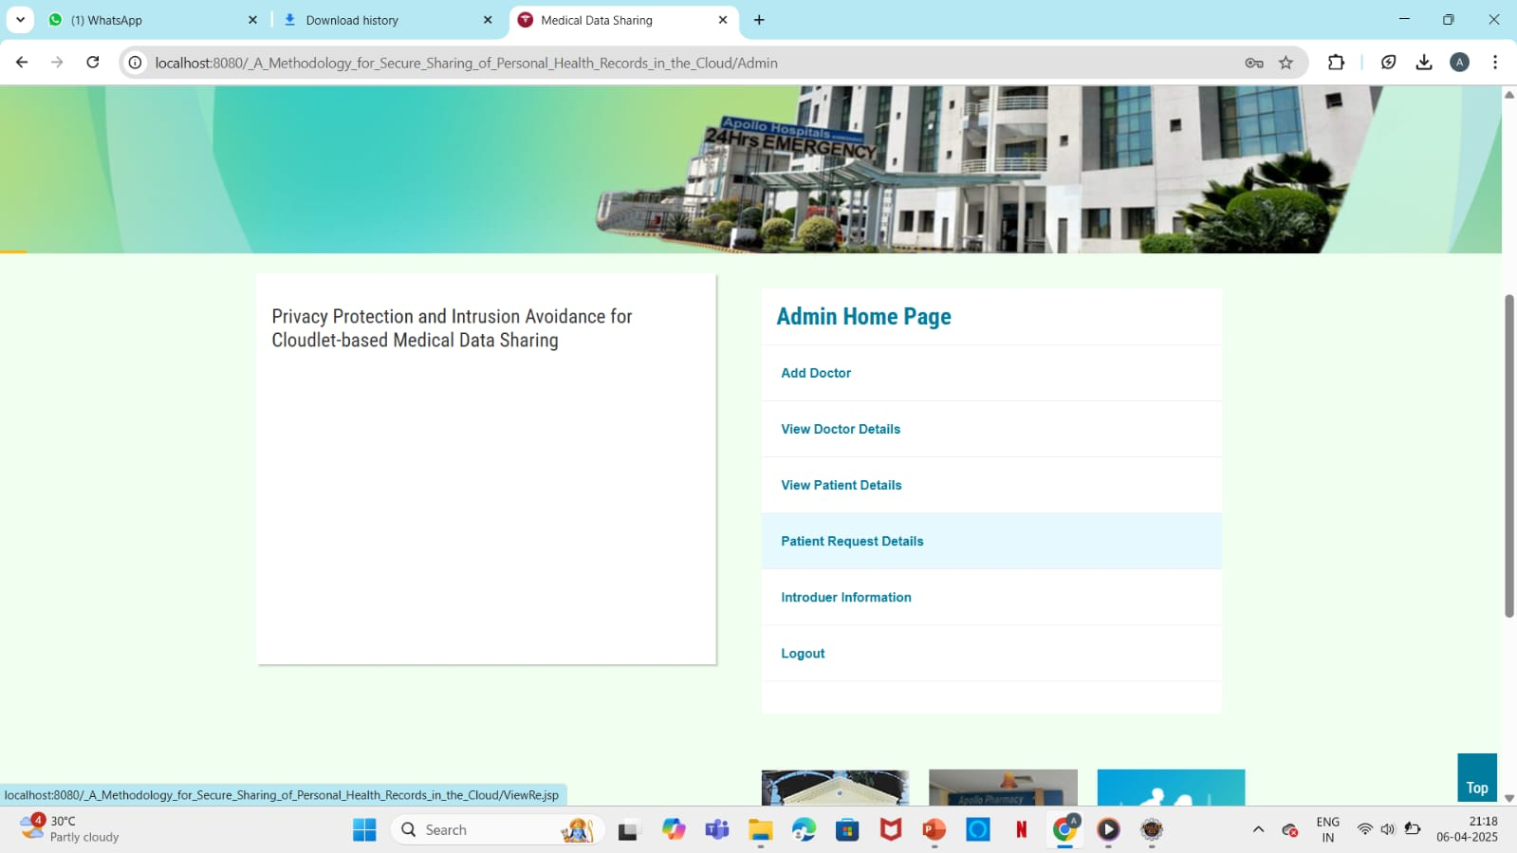
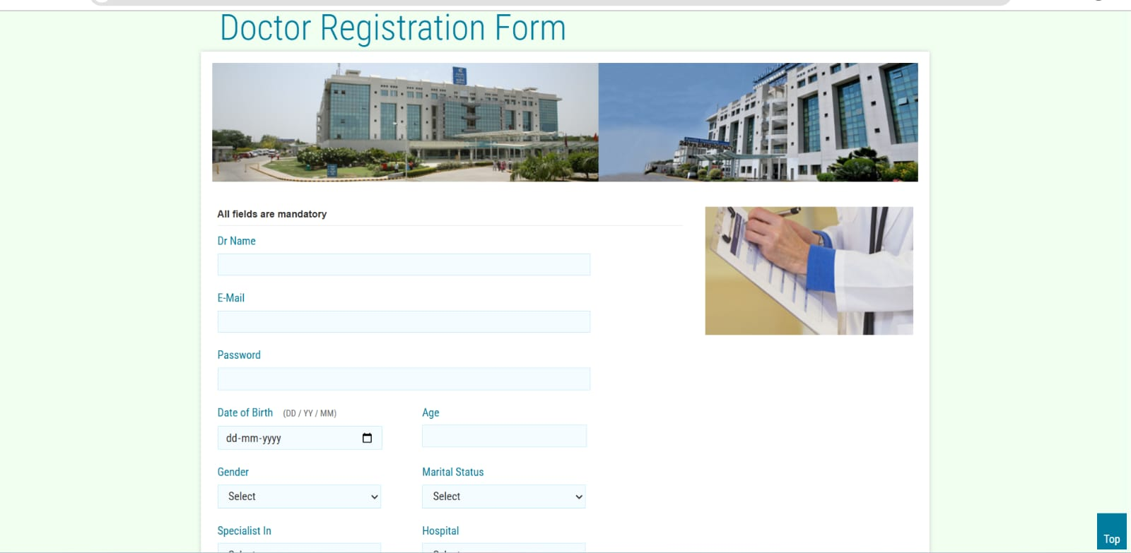

Slide 16
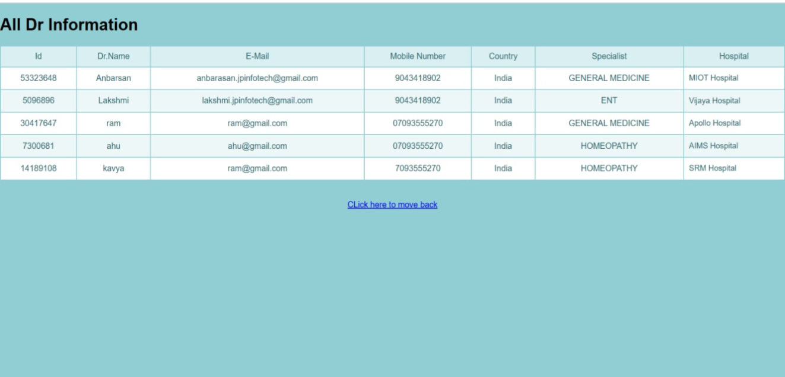
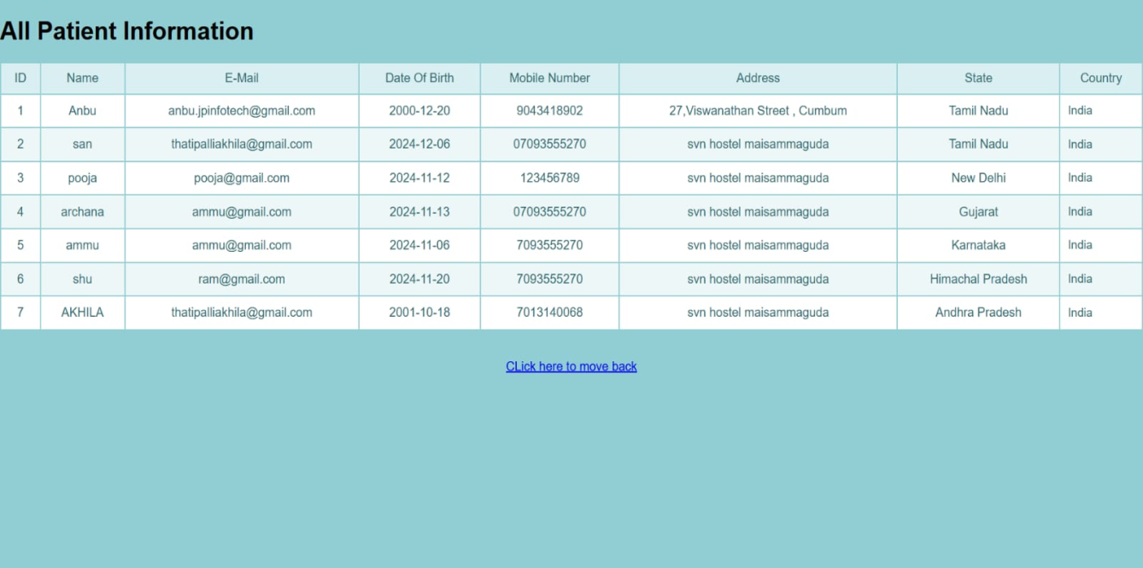

Slide 17
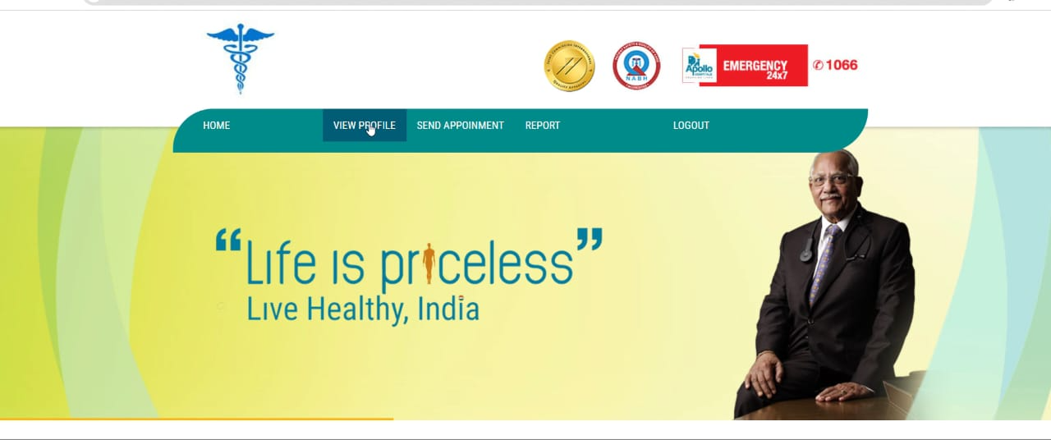
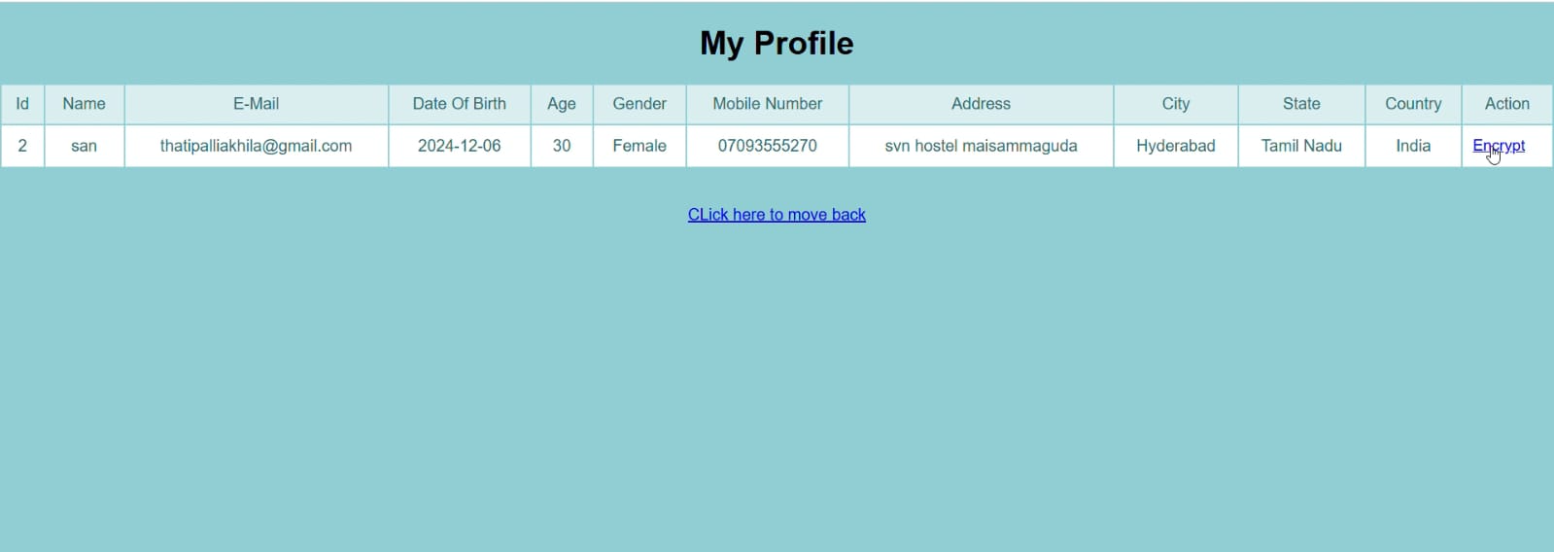

Slide 18
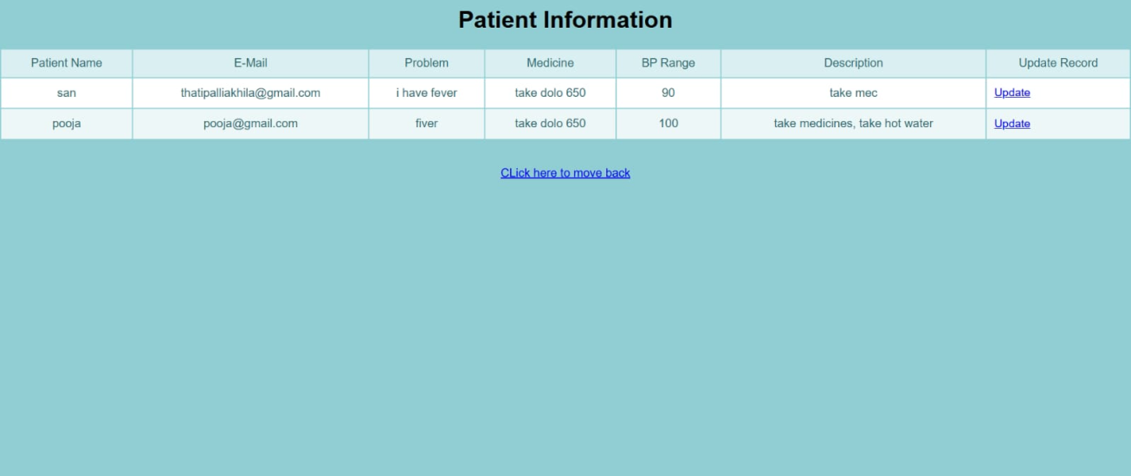
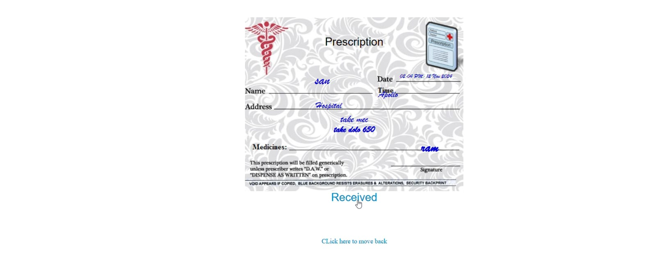

Slide 19
FUTURE SCOPE
The future scope of personal health records (PHRs) in the cloud involves enhanced patient engagement, improved data accessibility, and advancements in healthcare delivery through technologies like AI and data analytics, while addressing security and privacy concerns.
Enhanced Patient Engagement and Empowerment:
Cloud-based PHRs enable patients to access their medical history, test results, and appointments anytime, anywhere, fostering a more proactive approach to their health management.
Improved Data Accessibility and Interoperability:
Cloud storage facilitates seamless sharing of health information between healthcare providers, leading to better coordination of care and more informed decision-making.

Slide 20
CONCLUSION
We proposed a methodology to securely store and transmission of the PHRs to the authorized entities in the cloud.
The methodology preserves the confidentiality of the PHRs and enforces a patient-centric access control to different portions of the PHRs based on the access provided by the patients.
We implemented a fine-grained access control method in such a way that even the valid system users cannot access those portions of the PHR for which they are not authorized.
The PHR owners store the encrypted data on the cloud and only the authorized users possessing valid re- encryption keys issued by a semi trusted proxy are able to decrypt the PHRs.

Slide 21
REFERENCES
[1]Min Chen, Senior Member, IEEE, Yongfeng Qian, Jing Chen,Kai Hwang, Fellow, IEEE, Shiwen Mao, Senior Member, Long Hu, “Privacy Protection and Intrusion Avoidance for Cloudlet-based Medical Data Sharing”, IEEE Transactions on Cloud Computing, 2017.
[2]Tambe, G. SeSPHR: A METHODOLOGY FOR SECURE SHARING OF PERSONAL HEALTH RECORDS IN THE CLOUD.
[3] K. Gai, M. Qiu, and X. Sun, “A survey on FinTech,” Journal of Network and K. Gai, M. Qiu, Z. Xiong, and M. Liu
[4]A. Abbas, K. Bilal, L. Zhang, and S. U. Khan, “A cloud based health insurance plan recommendation system: A user centered approach, “Future Generation Computer
Systems, vols. 4344, pp

Slide 22


